Slide 1
Unit 11 Principal Component Analysis
EL-Gy 6143: Introduction to machine learning
Prof. pei liu

Slide 2
Learning Objectives
Identify cases to use dimensionality reduction
Mathematically describe principal components representations of data
Compute principal components via SVDs
Compute PC components in python
Add PCA transforms as a pre-processing step to classification and regression
Implement low-rank transforms for recommender systems

Slide 3
Outline
Why dimensionality reduction?
Principal components and directions of variance
Approximation with PCs
Computing PCs via the SVD
Face example in python
Training models from PCs
Low rank approximations and recommender systems

Slide 4
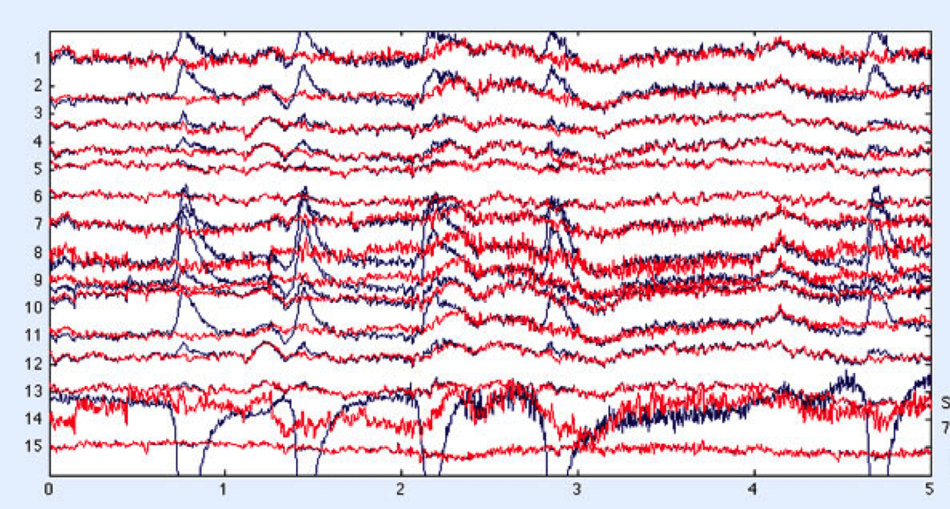
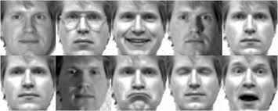
High-Dimensional Data
Many data sets have very high dimension
Training can be difficult
Especially when number of samples is small
Classifier needs many parameters
EEG Ex: 32 channels x 1 kHz x 10s
Face recognition with high-resolution images

Slide 5
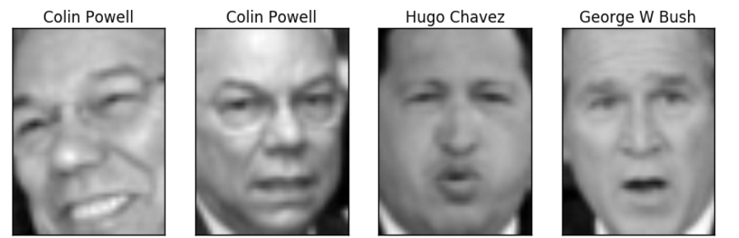
Problems with High-Dimensions
Consider face recognition
Input is high-dimensional
Esp. for high resolution image
Resulting classifier:
Requires many parameters
Difficult to train
Needs many samples
Computationally complex
Face
Classifier
Colin Powell
High-dim input
Complex, difficult to train

Slide 6
Dimensionality Reduction
High-dim input
Dimensionality Reduction
Simple Classifier
Low-dim
Colin Powell
Dimensionality reduction:
Reduce the input dimension to lower dimensional representation
Can build simpler classifier
Low-dimensional representational also good for:
Visualizing data
Clustering and other unsupervised tasks
Finding underlying structure of the data

Slide 7
Outline
Dimensionality reduction
Principal components and directions of variance
Approximation with PCs
Computing PCs via the SVD
Face example in python
Training models from PCs
Low rank approximations and recommender systems

Slide 8
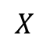
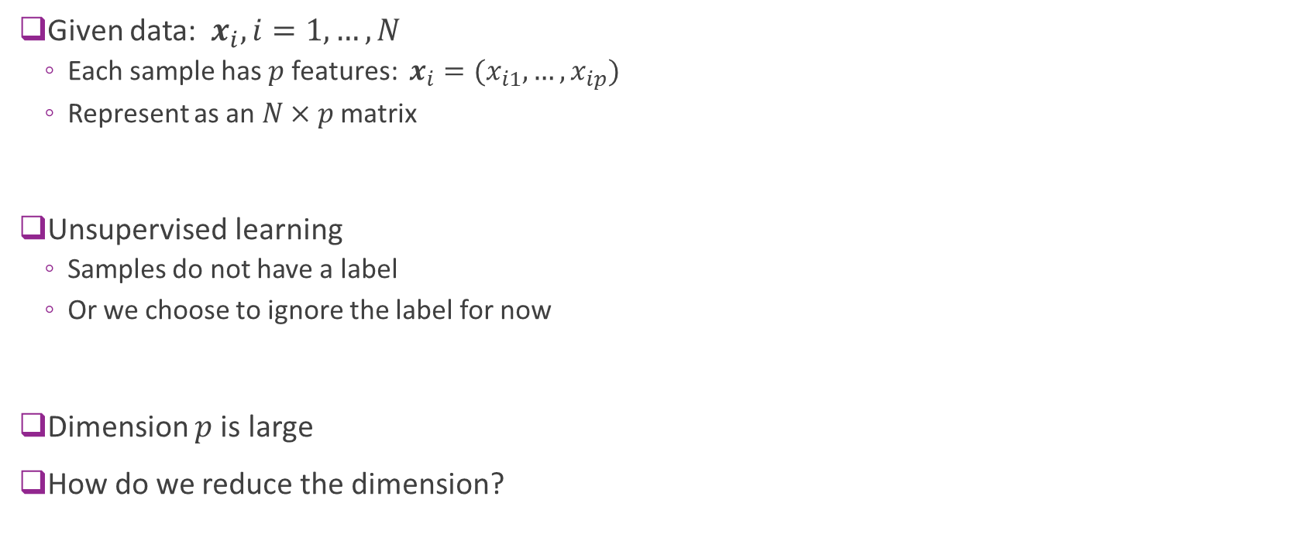
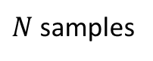
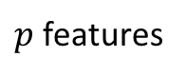
Data Definitions
Given data: $x_{i}, i=1,…,N$
Each sample has $p$ features: $x_{i}=(x_{i1},…,x_{ip})$
Represent as an $N×p$ matrix
Unsupervised learning
Samples do not have a label
Or we choose to ignore the label for now
Dimension $p$is large
How do we reduce the dimension?
$p$ features
$N$ samples
$$X$$

Slide 9
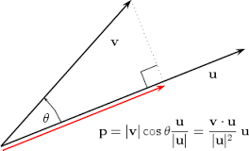
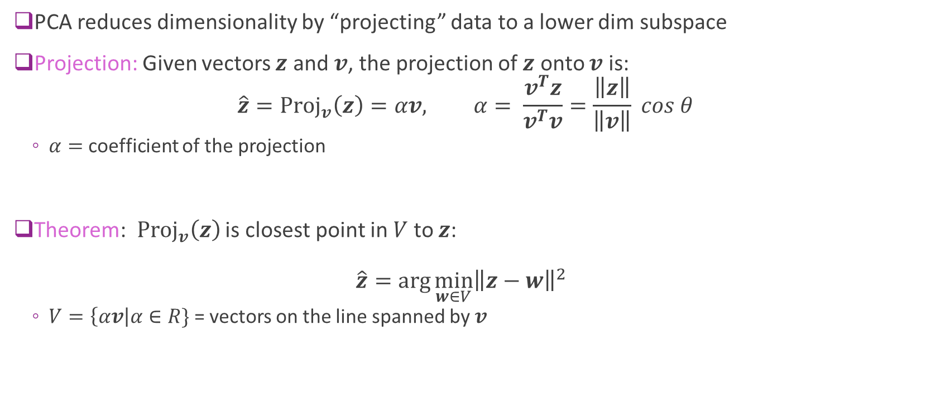
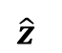
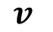
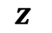
Projections
PCA reduces dimensionality by “projecting” data to a lower dim subspace
Projection: Given vectors $z$ and $v$, the projection of $z$ onto $v$ is: $\hat{z}={\text{Proj}}_{v}\left(z\right)=αv, α= \frac{v^{T}z}{v^{T}v}=\frac{\left\|z\right\|}{\left\|v\right\|} cos θ$
$α=$ coefficient of the projection
Theorem: ${\text{Proj}}_{v}\left(z\right)$ is closest point in $V$ to $z$: $\hat{z}=\arg{\min_{w∈V}{{\left\|z−w\right\|}^{2}}}$
$V=\left\{αv\right|α∈R\}$ = vectors on the line spanned by $v$
$$z$$
$$v$$
$$\hat{z}$$

Slide 10
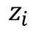
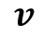
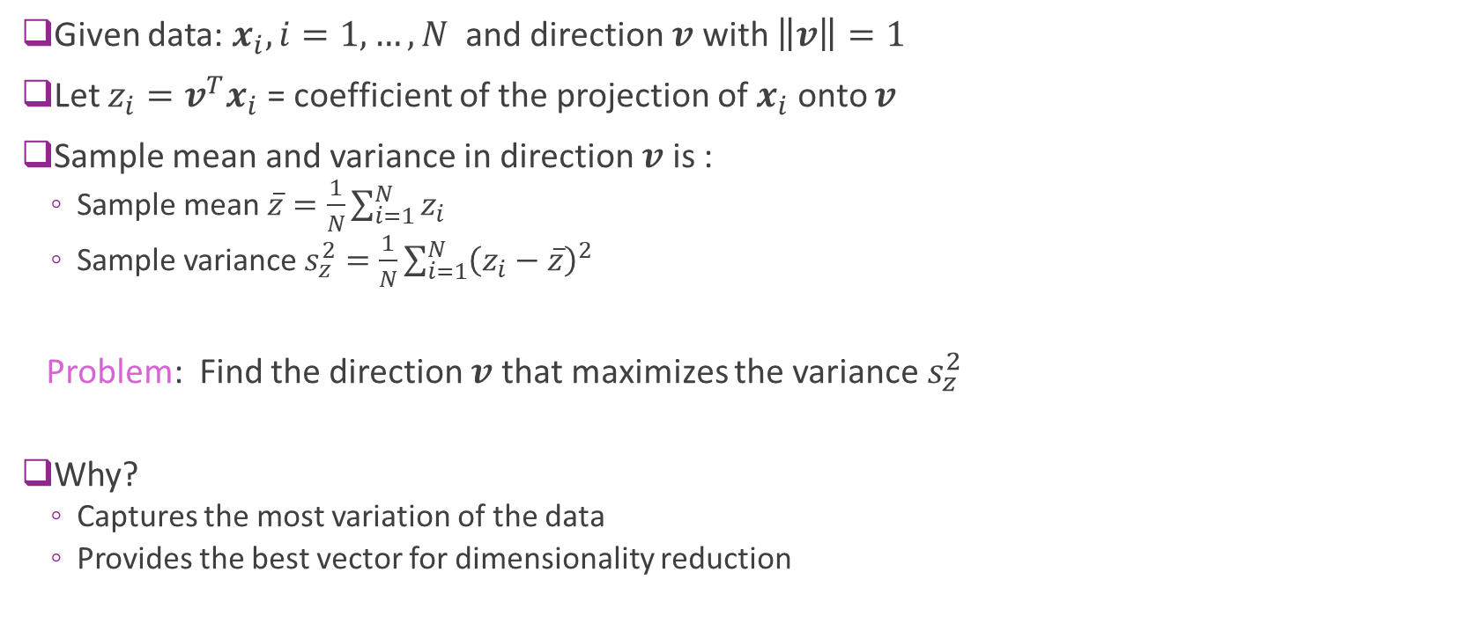
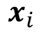
Maximal Directional Variance
Given data: $x_{i}, i=1,…,N$ and direction $v$ with $\left\|v\right\|=1$
Let $z_{i}=v^{T}x_{i}$ = coefficient of the projection of $x_{i}$ onto $v$
Sample mean and variance in direction $v$ is :
Sample mean $\overline{z}=\frac{1}{N}\sum_{i=1}^{N}{z_{i}}$
Sample variance $s_{z}^{2}=\frac{1}{N}\sum_{i=1}^{N}{{\left(z_{i}−\overline{z}\right)}^{2}}$
Problem: Find the direction $v$ that maximizes the variance $s_{z}^{2}$
Why?
Captures the most variation of the data
Provides the best vector for dimensionality reduction
$$x_{i}$$
$$v$$
$$z_{i}$$

Slide 11
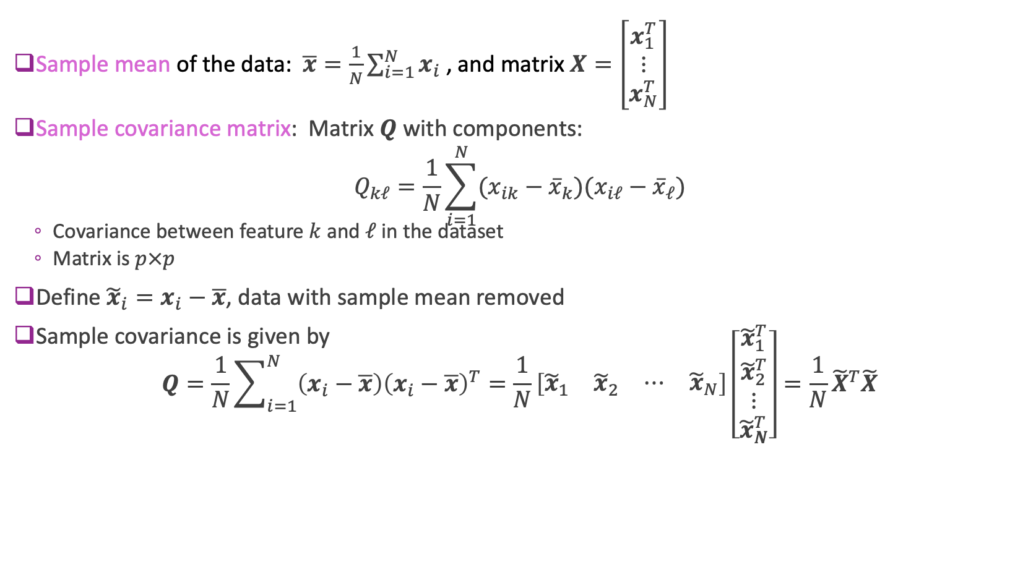
Sample Covariance Matrix
Sample mean of the data: $\overline{x}=\frac{1}{N}\sum_{i=1}^{N}{x_{i} }$, and matrix $X=\left[\begin{matrix}x_{1}^{T} \\ ⋮ \\ x_{N}^{T}\end{matrix}\right]$
Sample covariance matrix: Matrix $Q$ with components: $Q_{kℓ}=\frac{1}{N}\sum_{i=1}^{N}{(x_{ik}−{\overline{x}}_{k})(x_{iℓ}−{\overline{x}}_{ℓ})}$
Covariance between feature $k$ and $ℓ$ in the dataset
Matrix is $p×p$
Define ${\tilde{x}}_{i}=x_{i}−\overline{x}$, data with sample mean removed
Sample covariance is given by $Q=\frac{1}{N}\sum_{i=1}^{N}{\left(x_{i}−\overline{x}\right){\left(x_{i}−\overline{x}\right)}^{T}}=\frac{1}{N}\left[\begin{matrix}{\tilde{x}}_{1} & {\tilde{x}}_{2} & \begin{matrix}⋯ & {\tilde{x}}_{N}\end{matrix}\end{matrix}\right]\left[\begin{matrix}{\tilde{x}}_{1}^{T} \\ \begin{matrix}{\tilde{x}}_{2}^{T} \\ ⋮\end{matrix} \\ {\tilde{x}}_{N}^{T}\end{matrix}\right]=\frac{1}{N}{\tilde{X}}^{T}\tilde{X}$

Slide 12
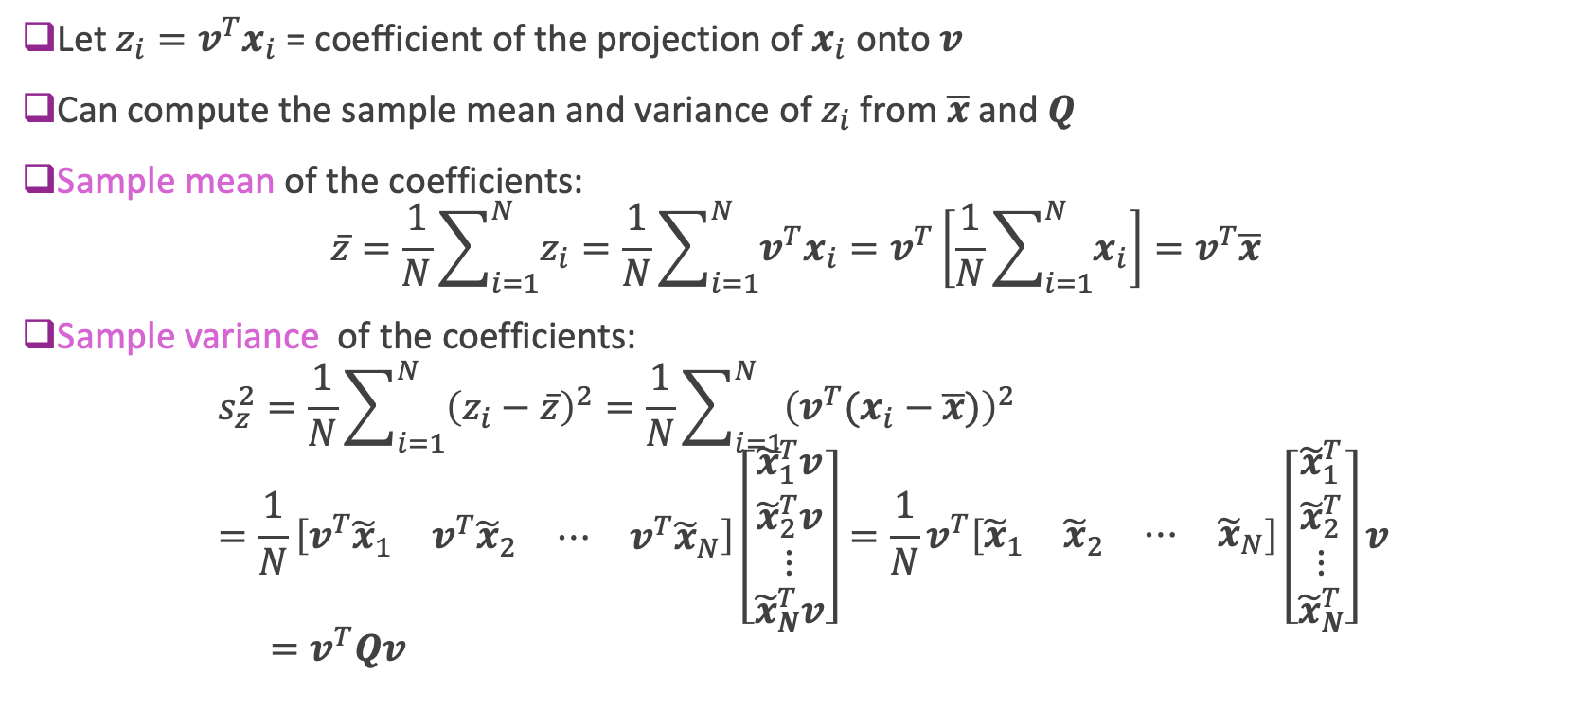
Sample Covariance and Directional Variance
Let $z_{i}=v^{T}x_{i}$ = coefficient of the projection of $x_{i}$ onto $v$
Can compute the sample mean and variance of $z_{i}$ from $\overline{x}$ and $Q$
Sample mean of the coefficients: $\overline{z}=\frac{1}{N}\sum_{i=1}^{N}{z_{i}}=\frac{1}{N}\sum_{i=1}^{N}{v^{T}x_{i}}=v^{T}\left[\frac{1}{N}\sum_{i=1}^{N}{x_{i}}\right]=v^{T}\overline{x}$
Sample variance of the coefficients:
$$s_{z}^{2}=\frac{1}{N}\sum_{i=1}^{N}{{\left(z_{i}−\overline{z}\right)}^{2}}=\frac{1}{N}\sum_{i=1}^{N}{{\left(v^{T}(x_{i}−\overline{x})\right)}^{2}} \\ =\frac{1}{N}\left[v^{T}\begin{matrix}{\tilde{x}}_{1} & {v^{T}\tilde{x}}_{2} & \begin{matrix}⋯ & {v^{T}\tilde{x}}_{N}\end{matrix}\end{matrix}\right]\left[\begin{matrix}{\tilde{x}}_{1}^{T}v \\ \begin{matrix}{\tilde{x}}_{2}^{T}v \\ ⋮\end{matrix} \\ {\tilde{x}}_{N}^{T}v\end{matrix}\right]=\frac{1}{N}v^{T}\left[\begin{matrix}{\tilde{x}}_{1} & {\tilde{x}}_{2} & \begin{matrix}⋯ & {\tilde{x}}_{N}\end{matrix}\end{matrix}\right]\left[\begin{matrix}{\tilde{x}}_{1}^{T} \\ \begin{matrix}{\tilde{x}}_{2}^{T} \\ ⋮\end{matrix} \\ {\tilde{x}}_{N}^{T}\end{matrix}\right]v \\ =v^{T}Qv$$

Slide 13
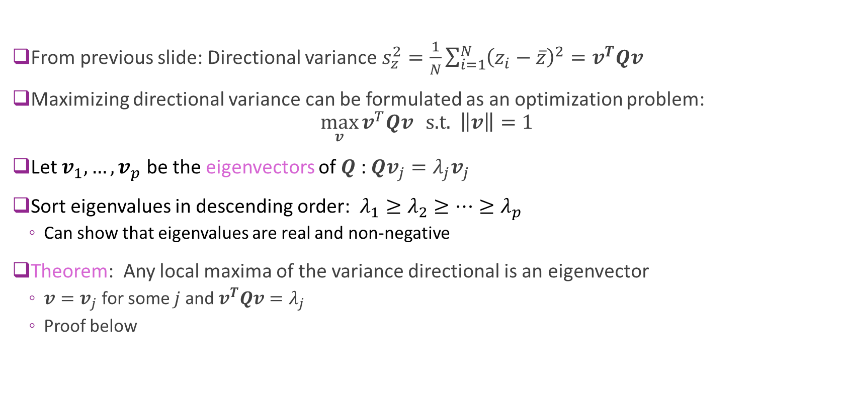
Maximizing Directional Variance
From previous slide: Directional variance $s_{z}^{2}=\frac{1}{N}\sum_{i=1}^{N}{{\left(z_{i}−\overline{z}\right)}^{2}}=v^{T}Qv$
Maximizing directional variance can be formulated as an optimization problem: $\max_{v}{v^{T}Qv} \text{s}\text{.}\text{t}\text{. } \left\|v\right\|=1$
Let $v_{1},…,v_{p}$ be the eigenvectors of $Q$ : $Qv_{j}=λ_{j}v_{j}$
Sort eigenvalues in descending order: $λ_{1}≥λ_{2}≥…≥λ_{p}$
Can show that eigenvalues are real and non-negative
Theorem: Any local maxima of the variance directional is an eigenvector
$v=v_{j}$ for some $j$ and $v^{T}Qv=λ_{j}$
Proof below

Slide 14
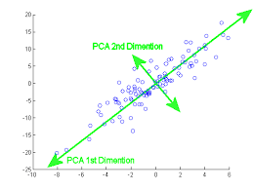
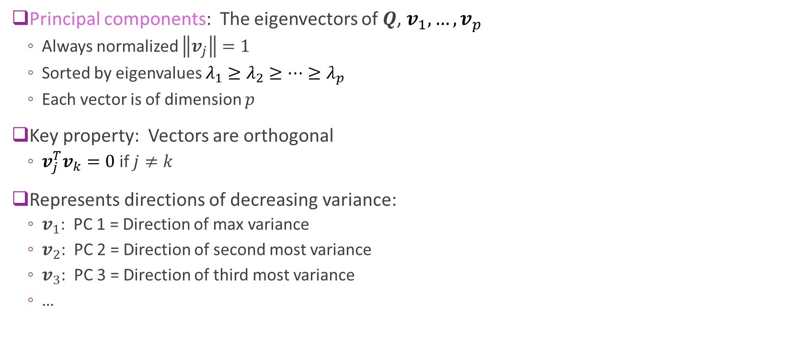
Visualizing Principal Components
Principal components: The eigenvectors of $Q$, $v_{1},…,v_{p}$
Always normalized $\left\|v_{j}\right\|=1$
Sorted by eigenvalues $λ_{1}≥λ_{2}≥…≥λ_{p}$
Each vector is of dimension $p$
Key property: Vectors are orthogonal
$v_{j}^{T}v_{k}=0$ if $j≠k$
Represents directions of decreasing variance:
$v_{1}$: PC 1 = Direction of max variance
$v_{2}$: PC 2 = Direction of second most variance
$v_{3}$: PC 3 = Direction of third most variance
…

Slide 15
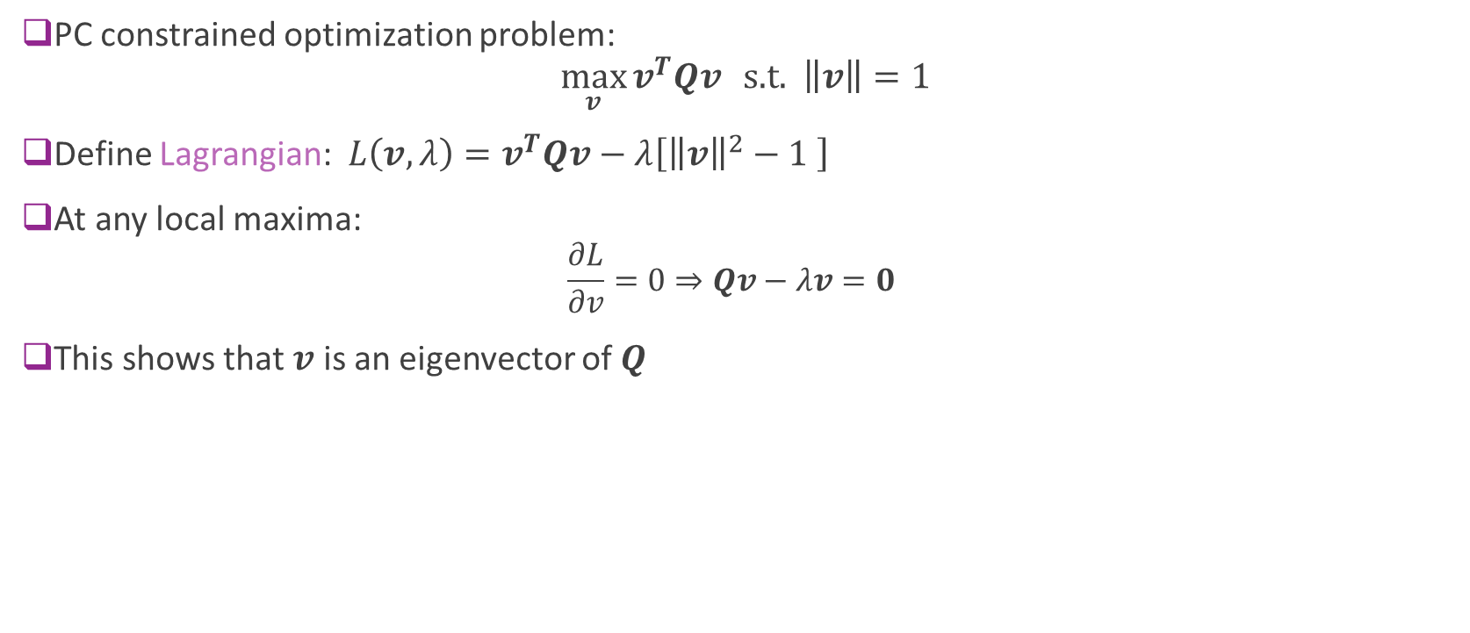

Proof PCs = Eigenvectors of $Q$
PC constrained optimization problem: $\max_{v}{v^{T}Qv} \text{s}\text{.}\text{t}\text{. } \left\|v\right\|=1$
Define Lagrangian: $L\left(v,λ\right)=v^{T}Qv−λ\left[{\left\|v\right\|}^{2}−1 \right]$
At any local maxima:
$$\frac{∂L}{∂v}=0⇒Qv−λv=0$$
This shows that $v$ is an eigenvector of $Q$

Slide 16
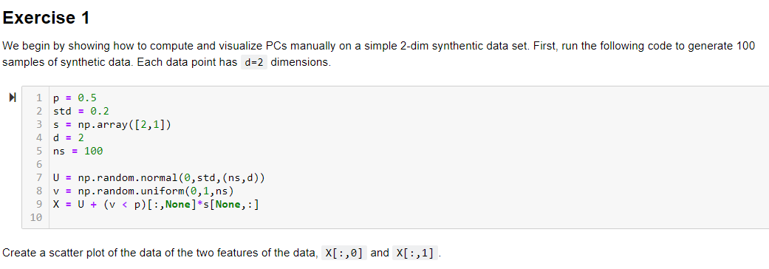
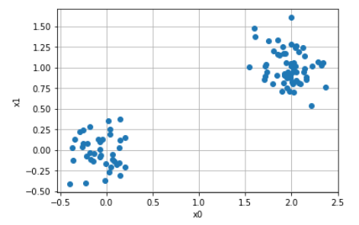
In-Class Exercise

Slide 17
Outline
Dimensionality reduction
Principal components and directions of variance
Approximation with PCs
Computing PCs via the SVD
Face example in python
Training models from PCs
Low rank approximations and recommender systems

Slide 18
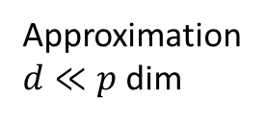
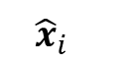

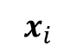
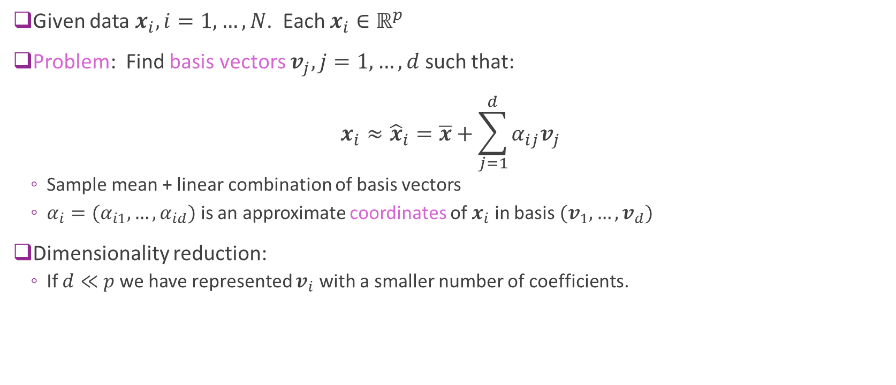
Low-Dimensional Representations
Given data $x_{i}, i=1,…,N$. Each $x_{i}∈ℝ^{p}$
Problem: Find basis vectors $v_{j}, j=1,…,d$ such that: $x_{i}≈{\hat{x}}_{i}=\overline{x}+\sum_{j=1}^{d}{α_{ij}v_{j}}$
Sample mean + linear combination of basis vectors
$α_{i}=(α_{i1},…,α_{id})$ is an approximate coordinates of $x_{i}$ in basis $(v_{1},…,v_{d})$
Dimensionality reduction:
If $d≪p$ we have represented $v_{i}$ with a smaller number of coefficients.
Data, $p$ dim
$$x_{i}$$
$${\hat{x}}_{i}$$
Approximation $d≪p$ dim

Slide 19
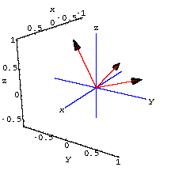
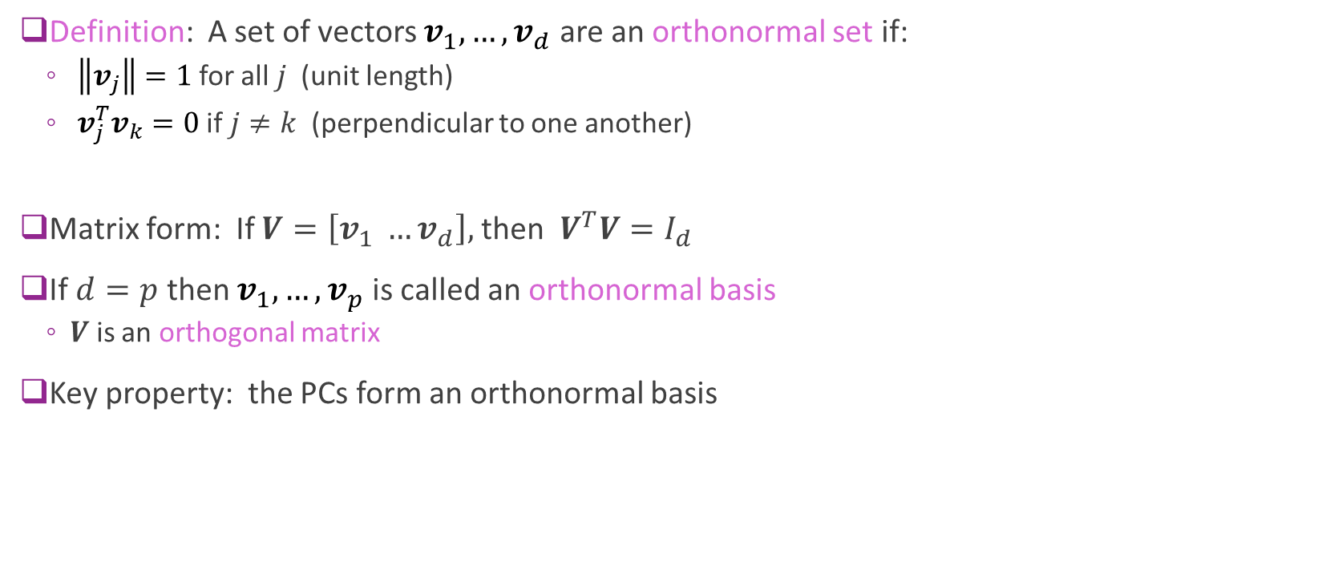
Orthonormal Sets and Bases
Definition: A set of vectors $v_{1},…,v_{d}$ are an orthonormal set if:
$\left\|v_{j}\right\|=1$ for all $j$ (unit length)
$v_{j}^{T}v_{k}=0$ if $j≠k$ (perpendicular to one another)
Matrix form: If $V=\left[v_{1} …v_{d}\right],$ then $V^{T}V=I_{d}$
If $d=p$ then $v_{1},…,v_{p}$ is called an orthonormal basis
$V$ is an orthogonal matrix
Key property: the PCs form an orthonormal basis

Slide 20
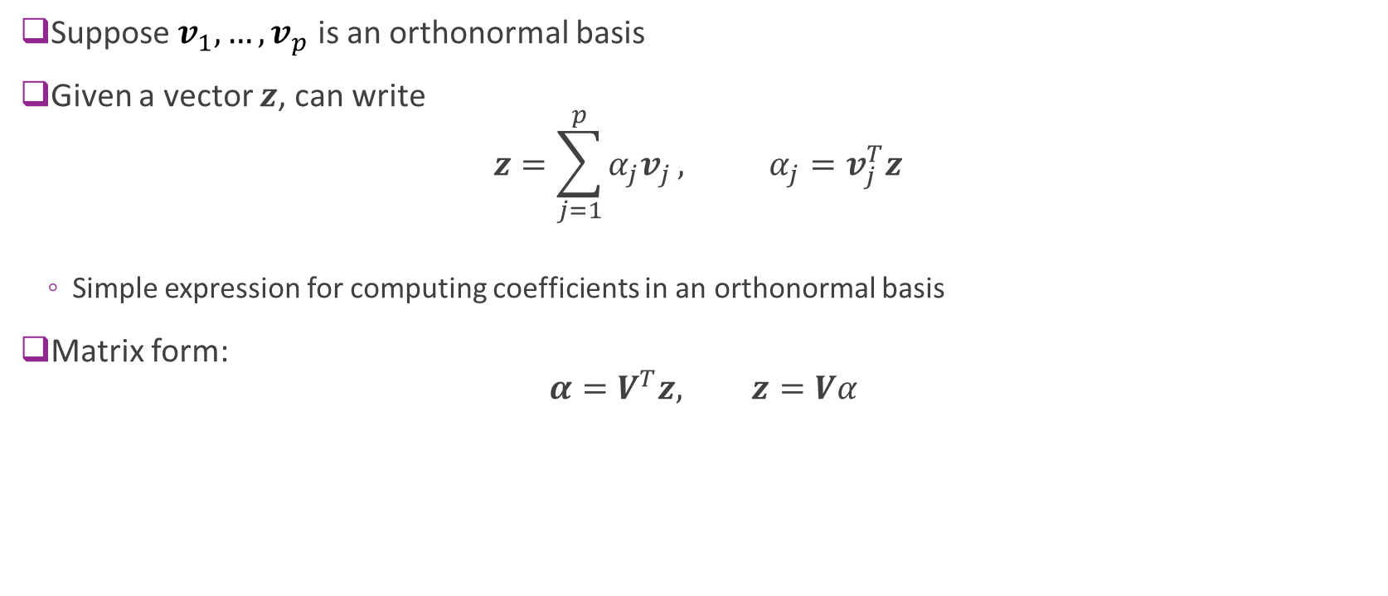
Coefficients in an Orthonormal Basis
Suppose $v_{1},…,v_{p}$ is an orthonormal basis
Given a vector $z$, can write $z=\sum_{j=1}^{p}{α_{j}v_{j}}, α_{j}=v_{j}^{T}z$
Simple expression for computing coefficients in an orthonormal basis
Matrix form: $α=V^{T}z, z=Vα$

Slide 21
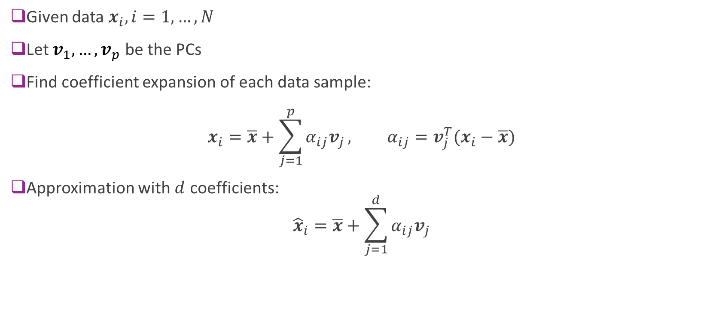
Approximating the Data Matrix
Given data $x_{i}, i=1,…,N$
Let $v_{1},…,v_{p}$ be the PCs
Find coefficient expansion of each data sample: $x_{i}=\overline{x}+\sum_{j=1}^{p}{α_{ij}v_{j}}, α_{ij}=v_{j}^{T}(x_{i}−\overline{x})$
Approximation with $d$ coefficients: ${\hat{x}}_{i}=\overline{x}+\sum_{j=1}^{d}{α_{ij}v_{j}}$

Slide 22
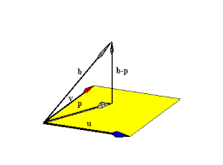
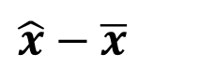
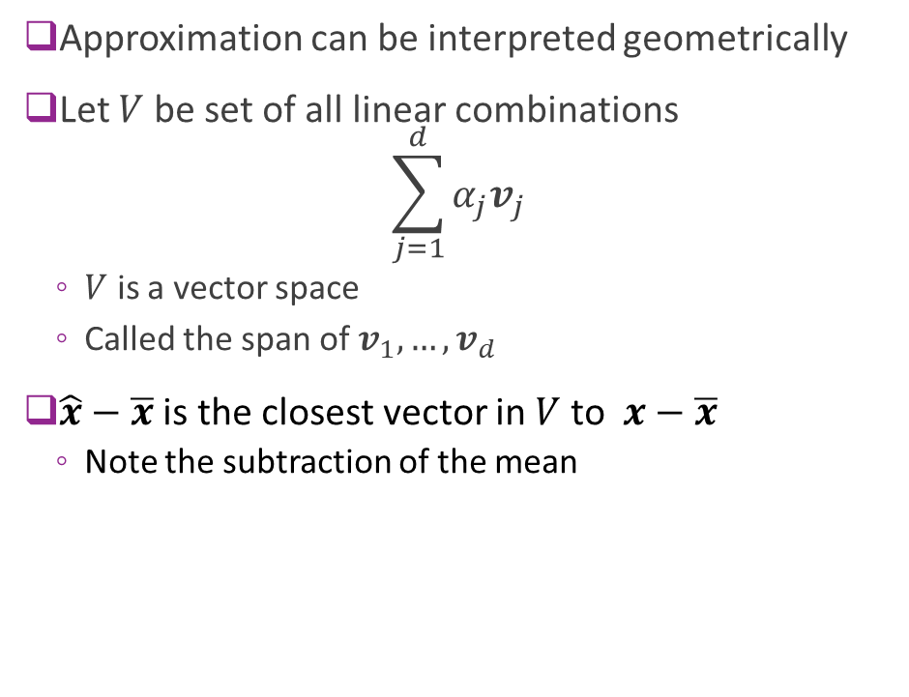
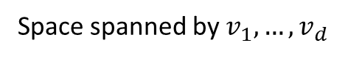
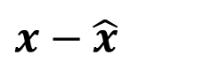
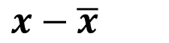
Geometry of Approximations
Approximation can be interpreted geometrically
Let $V$ be set of all linear combinations $\sum_{j=1}^{d}{α_{j}v_{j}}$
$V$ is a vector space
Called the span of $v_{1},…,v_{d}$
$\hat{x}−\overline{x}$ is the closest vector in $V$ to $x−\overline{x}$
Note the subtraction of the mean
$$x−\overline{x}$$
$$x−\hat{x}$$
$$\hat{x}−\overline{x}$$
Space spanned by $v_{1},…,v_{d}$

Slide 23
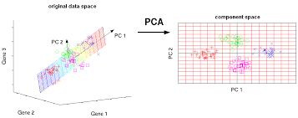
Visualizing the Representation
Finds a low-dimensional representation

Slide 24
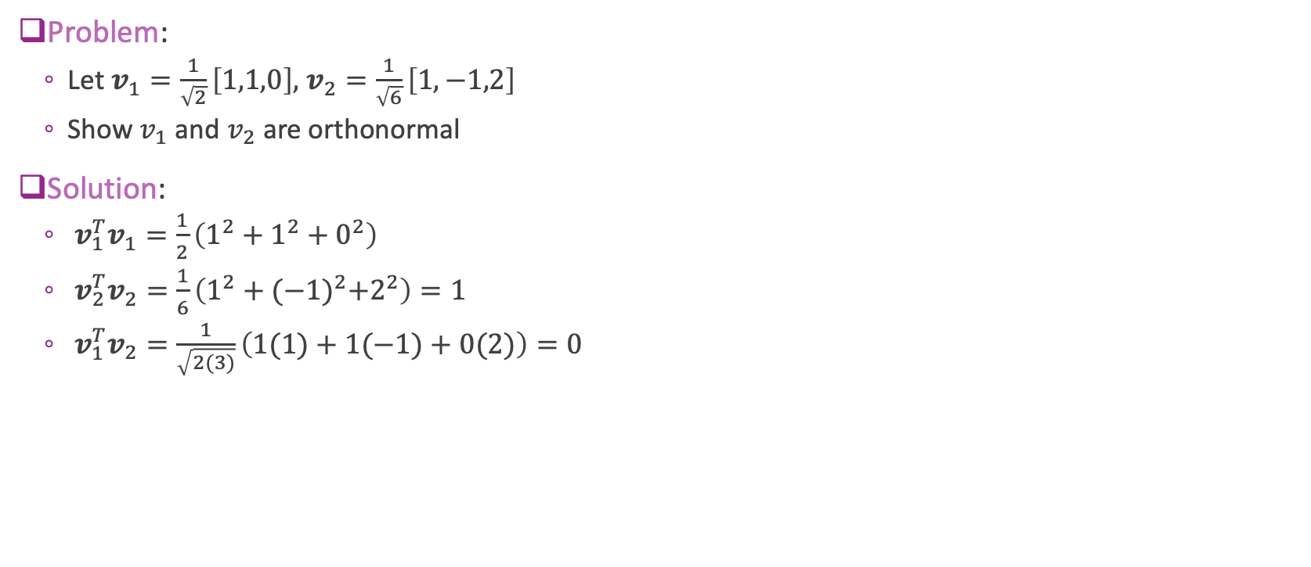
Example Calculation
Problem:
Let $v_{1}=\frac{1}{\sqrt{2}}\left[1,1,0\right],$ $v_{2}=\frac{1}{\sqrt{6}}\left[1,−1,2\right]$
Show $v_{1}$ and $v_{2}$ are orthonormal
Solution:
$v_{1}^{T}v_{1}=\frac{1}{2}\left(1^{2}+1^{2}+0^{2}\right)$
$v_{2}^{T}v_{2}=\frac{1}{6}\left(1^{2}+{(−1)}^{2}+2^{2}\right)=1$
$v_{1}^{T}v_{2}=\frac{1}{\sqrt{2(3)}}\left(1(1)+1(−1)+0(2)\right)=0$

Slide 25
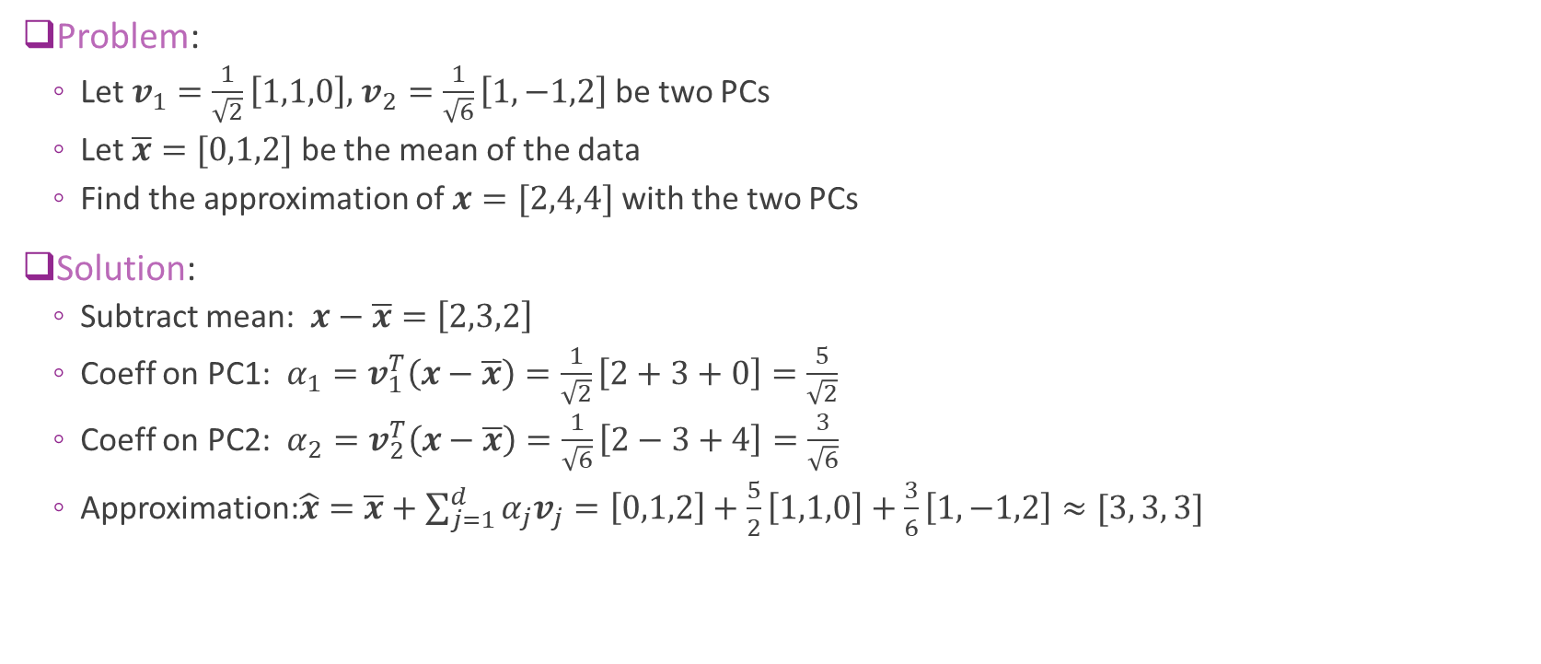
Example Calculation Continued
Problem:
Let $v_{1}=\frac{1}{\sqrt{2}}\left[1,1,0\right],$ $v_{2}=\frac{1}{\sqrt{6}}\left[1,−1,2\right]$ be two PCs
Let $\overline{x}=[0,1,2]$ be the mean of the data
Find the approximation of $x=[2,4,4]$ with the two PCs
Solution:
Subtract mean: $x−\overline{x}=\left[2,3,2\right]$
Coeff on PC1: $α_{1}=v_{1}^{T}\left(x−\overline{x}\right)=\frac{1}{\sqrt{2}}\left[2+3+0\right]=\frac{5}{\sqrt{2}}$
Coeff on PC2: $α_{2}=v_{2}^{T}\left(x−\overline{x}\right)=\frac{1}{\sqrt{6}}\left[2−3+4\right]=\frac{3}{\sqrt{6}}$
Approximation:$\hat{x}=\overline{x}+\sum_{j=1}^{d}{α_{j}v_{j}}=\left[0,1,2\right]+\frac{5}{2}\left[1,1,0\right]+\frac{3}{6}\left[1,−1,2\right]≈[3, 3, 3]$

Slide 26

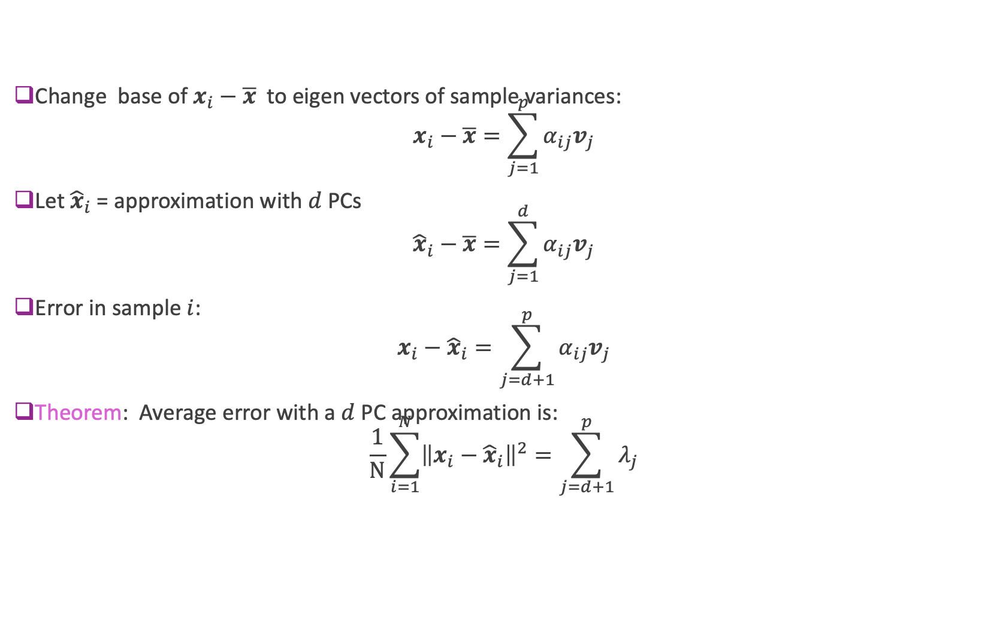
Average Approximation Error
Change base of $x_{i}−\overline{x}$ to eigen vectors of sample variances: $x_{i}−\overline{x}=\sum_{j=1}^{p}{α_{ij}v_{j}}$
Let ${\hat{x}}_{i}$ = approximation with $d$ PCs ${\hat{x}}_{i}−\overline{x}=\sum_{j=1}^{d}{α_{ij}v_{j}}$
Error in sample $i$: $x_{i}−{\hat{x}}_{i}=\sum_{j=d+1}^{p}{α_{ij}v_{j}}$
Theorem: Average error with a $d$ PC approximation is: $\frac{1}{N}\sum_{i=1}^{N}{{\left\|x_{i}−{\hat{x}}_{i}\right\|}^{2}}=\sum_{j=d+1}^{p}{λ_{j}}$
Eigen vectors sorted by decreasing order of eigenvalues
Sum of the smallest $p−d$ eigenvalues

Slide 27
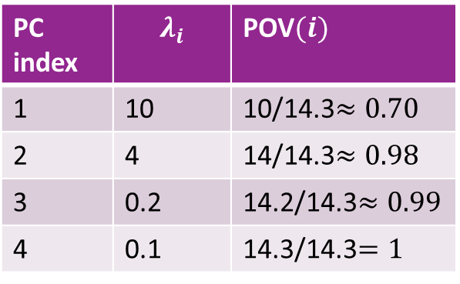
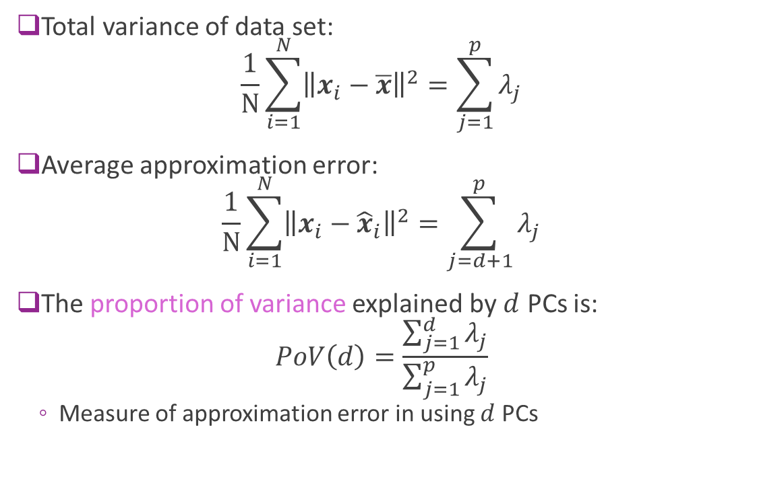
Proportion of Variance (PoV)
Trace of covariance matrix
Total variance of data set: $\frac{1}{N}\sum_{i=1}^{N}{{\left\|x_{i}−\overline{x}\right\|}^{2}}=\sum_{j=1}^{p}{λ_{j}}$
Average approximation error: $\frac{1}{N}\sum_{i=1}^{N}{{\left\|x_{i}−{\hat{x}}_{i}\right\|}^{2}}=\sum_{j=d+1}^{p}{λ_{j}}$
The proportion of variance explained by $d$ PCs is: $PoV\left(d\right)=\frac{\sum_{j=1}^{d}{λ_{j}}}{\sum_{j=1}^{p}{λ_{j}}}$
Measure of approximation error in using $d$ PCs
Example
PC index | $$λ_{i}$$ | POV$(i)$
1 | 10 | 10/14.3$≈0.70$
2 | 4 | 14/14.3$≈0.98$
3 | 0.2 | 14.2/14.3$≈0.99$
4 | 0.1 | 14.3/14.3$=1$

Slide 28
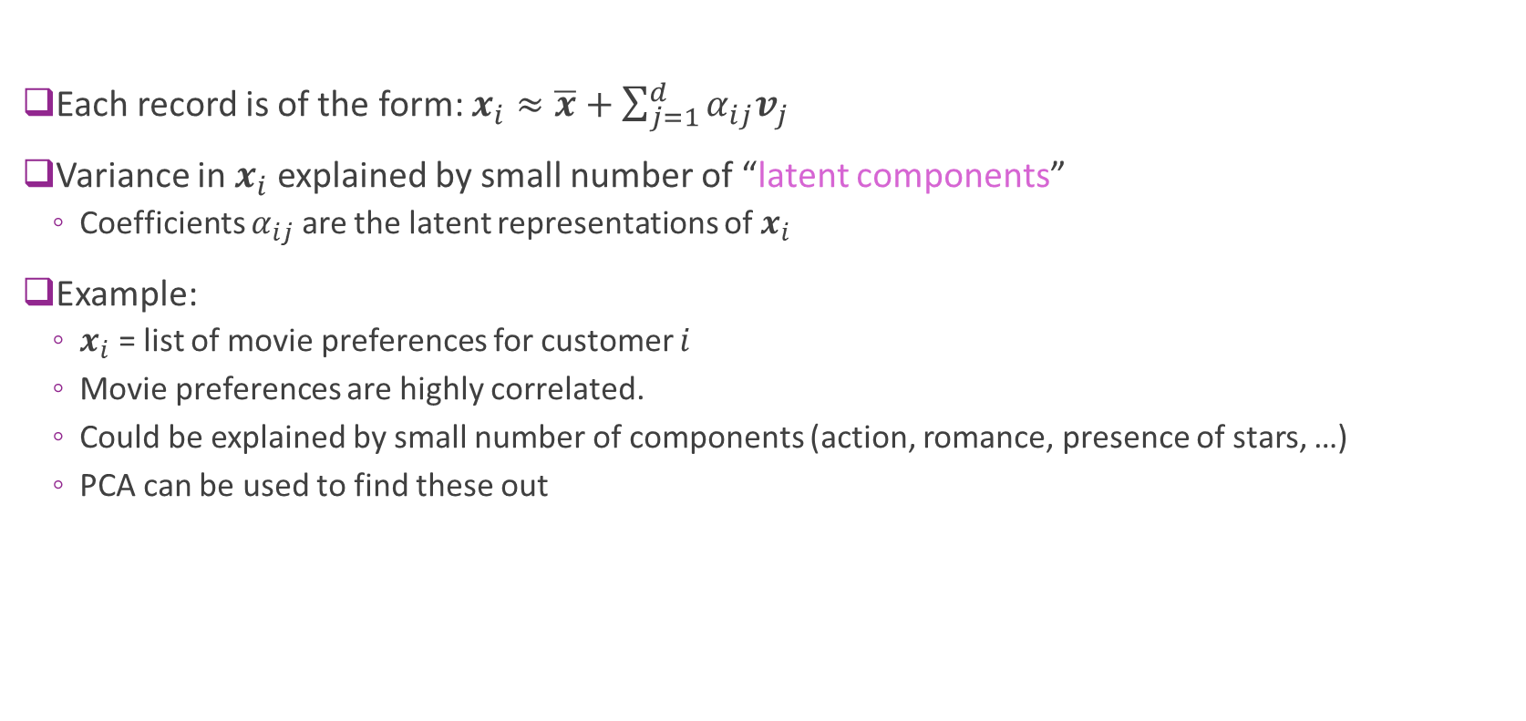
Latent Representations
Each record is of the form: $x_{i}≈\overline{x}+\sum_{j=1}^{d}{α_{ij}v_{j}}$
Variance in $x_{i}$ explained by small number of “latent components”
Coefficients $α_{ij}$ are the latent representations of $x_{i}$
Example:
$x_{i}$ = list of movie preferences for customer $i$
Movie preferences are highly correlated.
Could be explained by small number of components (action, romance, presence of stars, …)
PCA can be used to find these out

Slide 29
Example: USArrests
Arrests per capita in four categories
One record per US state
Visualize PCA in a biplot
See the scores (i.e. coefficients of each state)
Loading (PC vectors)
Fig from ISL 10.1

Slide 30
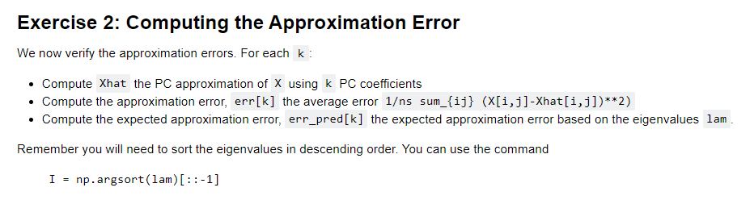
In-Class Exercise

Slide 31
Outline
Dimensionality reduction
Principal components and directions of variance
Approximation with PCs
Computing PCs via the SVD
Face example in python
Training models from PCs
Low rank approximations and recommender systems

Slide 32
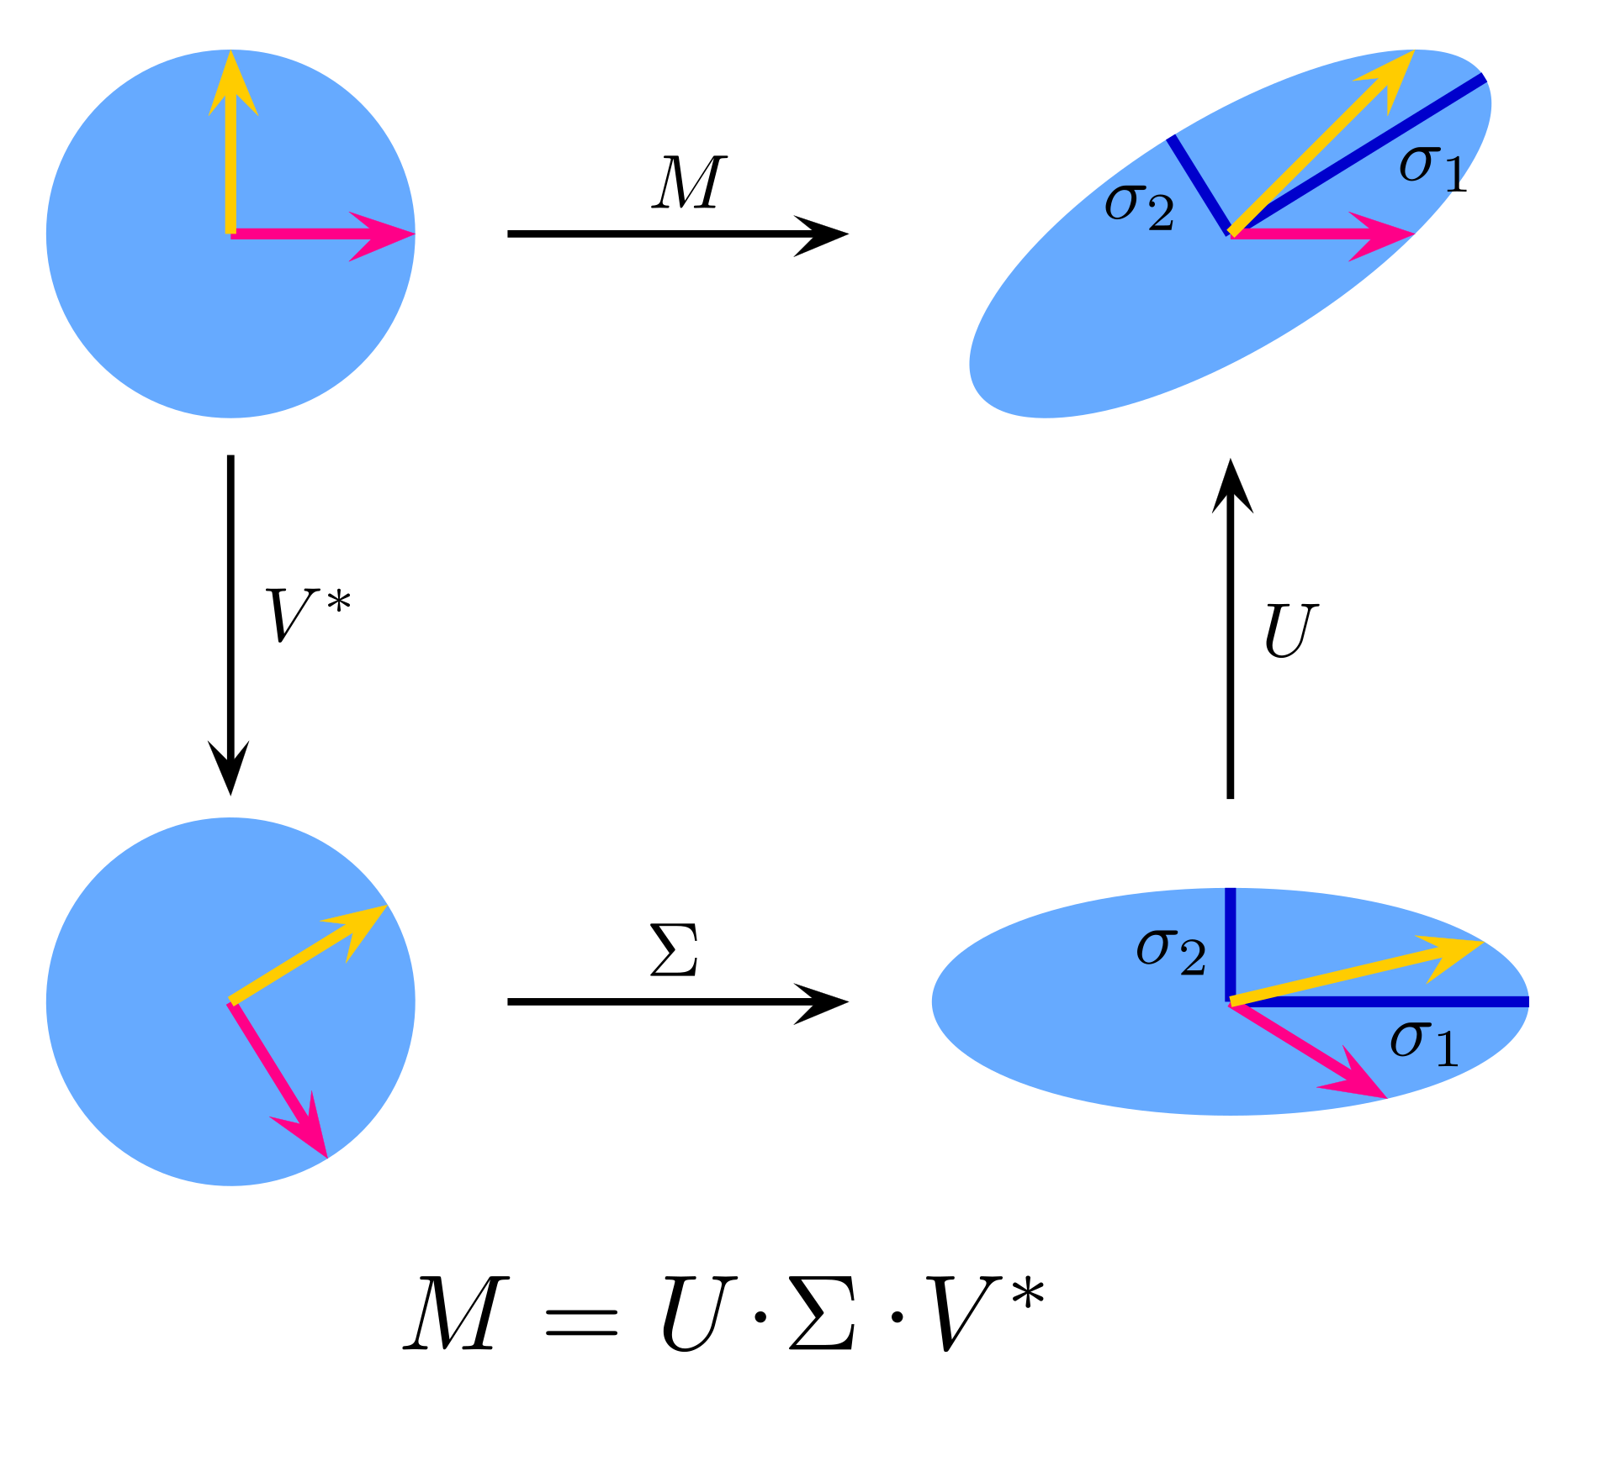
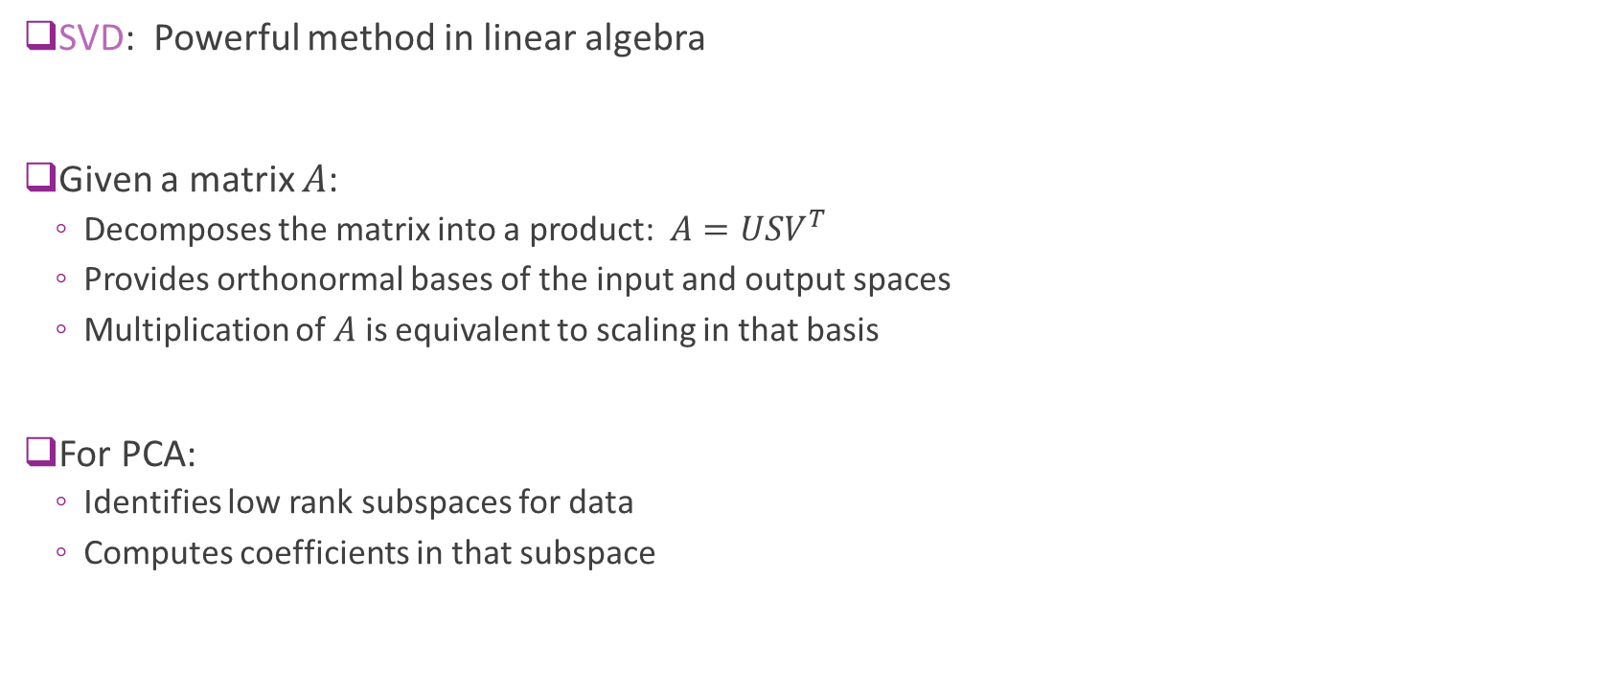
Singular Value Decomposition
SVD: Powerful method in linear algebra
Given a matrix $A$:
Decomposes the matrix into a product: $A=USV^{T}$
Provides orthonormal bases of the input and output spaces
Multiplication of $A$ is equivalent to scaling in that basis
For PCA:
Identifies low rank subspaces for data
Computes coefficients in that subspace
_{A}
_{A}
Notes:
SVD is a powerful techniuque in all kinds of numerical linear algebra/ml/etc.
It's just a way to compute principal component analysis
SVD is kind of like an eigenvalue decomposition that it factors the matrix into three parts.
S is diagonal, rxr, sorted called singular values.
All marix in universe has svd. Even if not square.

Slide 33
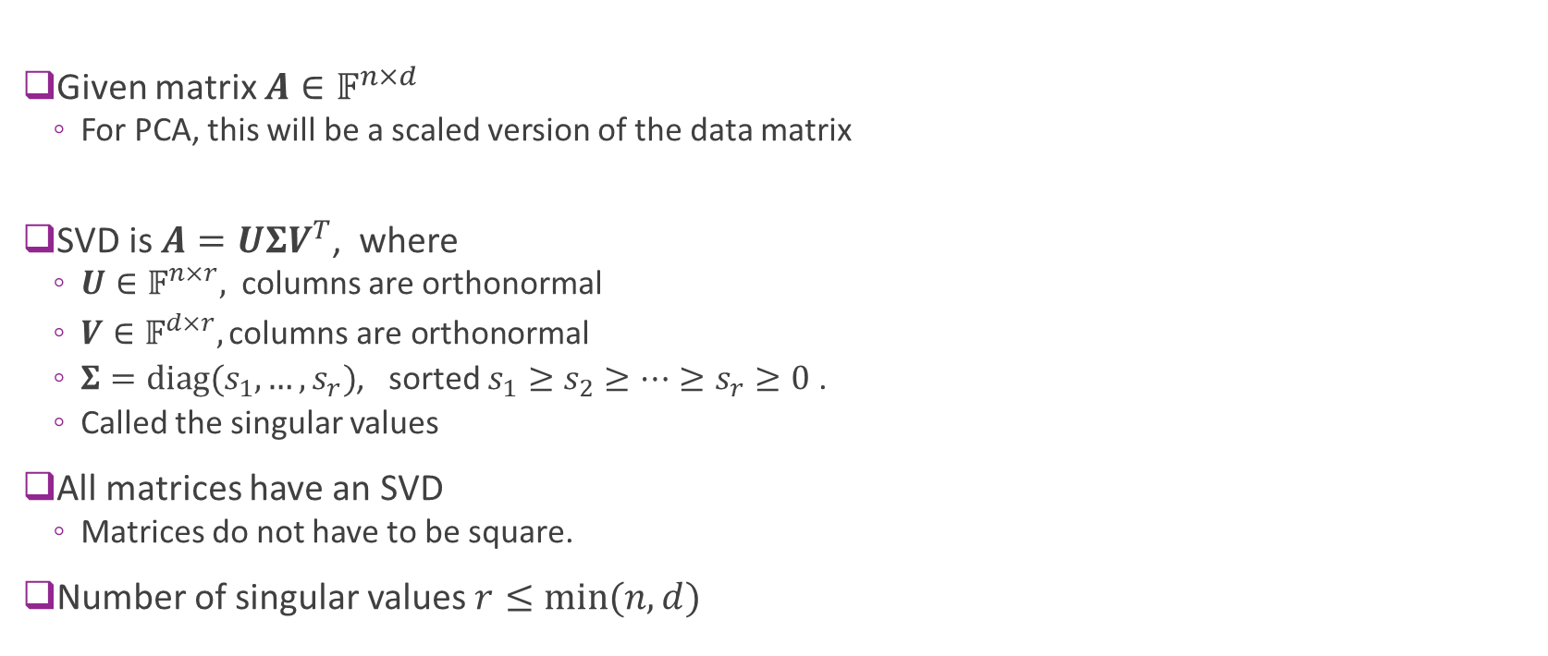
Singular Value Decomposition Defined
Given matrix $A∈𝔽^{n×d}$
For PCA, this will be a scaled version of the data matrix
SVD is $A=UΣV^{T}$, where
$U∈𝔽^{n×r},$columns are orthonormal
$V∈𝔽^{d×r}, \text{columns} \text{are} \text{orthonormal}$
$Σ=\text{diag}(s_{1},…,s_{r})$, sorted $s_{1}≥s_{2}≥⋯≥s_{r}≥0$ .
Called the singular values
All matrices have an SVD
Matrices do not have to be square.
Number of singular values $r≤\min{(n,d)}$
Notes:
SVD is a powerful techniuque in all kinds of numerical linear algebra/ml/etc.
It's just a way to compute principal component analysis
SVD is kind of like an eigenvalue decomposition that it factors the matrix into three parts.
S is diagonal, rxr, sorted called singular values.
All marix in universe has svd. Even if not square.

Slide 34
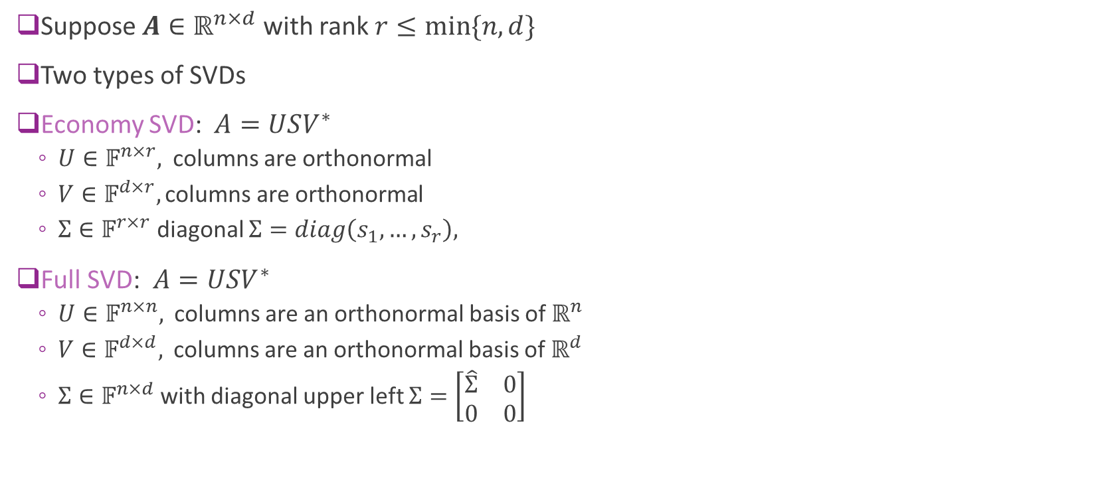
Economy vs. Full SVD
Suppose $A∈ℝ^{n×d}$ with rank $r≤min⁡\{n,d\}$
Two types of SVDs
Economy SVD:$A=USV^{∗}$
$U∈𝔽^{n×r},$columns are orthonormal
$V∈𝔽^{d×r}, \text{columns} \text{are} \text{orthonormal}$
$Σ∈𝔽^{r×r}$ diagonal $Σ=diag\left(s_{1},…,s_{r}\right),$
Full SVD:$A=USV^{∗}$
$U∈𝔽^{n×n},$ columns are an orthonormal basis of $ℝ^{n}$
$V∈𝔽^{d×d},$ columns are an orthonormal basis of $ℝ^{d}$
$Σ∈𝔽^{n×d}$with diagonal upper left $Σ=\left[\begin{matrix}\hat{Σ} & 0 \\ 0 & 0\end{matrix}\right]$

Slide 35

SVD Visualized
Pink matrices represent “economy” SVD
Blue represent “full SVD”
Tall
Diagonal
Fat

Slide 36





Example
Let $A=$
Then can check that $A=UΣV^{∗}$
Also verify that $UU^{∗}=I_{5}$ and $VV^{∗}=I_{5}$
This can be found by (cleverly) permute the rows of $A$
But, in general, use a computer to compute SVD

Slide 37



Geometric Interpretation
$$x$$
$$y$$
Matrix can be viewed as a linear transformation/map
$$y=Ax$$
Transform a vector $x$ to a vector $y$
$T:R^{p}→R^{n}$
The columns of $A$ are the coordinates of the transformed basis vectors
Check Essence of linear algebra on Youtube by 3Blue1Brown
https://www.youtube.com/playlist?list=PLZHQObOWTQDPD3MizzM2xVFitgF8hE_ab
_{A}

Slide 38



Geometric Interpretation
Let $A=UΣV^{∗}$ and $y=Ax$
Consider a transformed space
$w=V^{∗}x$ $=[w_{1},…,w_{N}]$ coefficients in input basis $V=[v_{1},…,v_{N}]$
$z=U^{∗}y=[z_{1},…,z_{M}]$: coefficients in output basis $U=[u_{1},…,u_{M}]$
Then: $z=Σw$ so $z_{i}=σ_{i}w_{i}$
Each input direction $v_{i}$ is mapped to $σ_{i}u_{i}$
Consequence:
SVD finds orthonormal bases $U,V$ such that matrix $A$ is a linear scaling in each basis vector
$$x$$
$$y$$
_{A}
_{A}

Slide 39

Example Problem
Suppose that $A=UΣV^{∗}∈ℝ^{3×4}$ with $Σ=diag(3,0.2,0,0)$
If $x=2v_{1}+3v_{2}+4v_{3}+5v_{4}$ find $y=Ax$in terms of basis $u_{1},u_{2},u_{3}$
Solution:
${Av}_{i}=σ_{i}u_{i}$ for all $i$
Therefore, $y=Ax=2{Av}_{1}+3{Av}_{2}+4Av_{3}+5{Av}_{4}$
$$=2{\left(3\right)u}_{1}+3{\left(0.2\right)u}_{2}+4\left(0\right)u_{3} \\ =6u_{1}+0.6 u_{2}$$

Slide 40






Computing the SVD in Python
Random matrix
Full SVD
Economy SVD
Reconstruction:

Slide 41

Computing the PCA via SVD
Let $A=\frac{1}{\sqrt{N}}\tilde{X}$ = scaled data matrix with sample mean removed.
Take SVD: $A={UΣV}^{T}$
Properties:
Sample covariance matrix is $Q=\frac{1}{N}{\tilde{X}}^{T}\tilde{X}=A^{T}A=VΣU^{T}UΣV^{T}=VΣ^{2}V^{T}$
Eigenvalues of $Q=$ squared singular values of $A$
PCs are $v_{j},$ columns of $V$
Coefficients are $Z=\tilde{X}V=\sqrt{N}AV=\sqrt{N}UΣ$
Hence, SVD provides PCs, eigenvalues coefficients $Z$in the PCA representation.
Notes:
How do we use the SVD to compute PCA?
Take data matrix X, remove the mean. Each row of x, subtract out the mean
The alphas j are singular values of
Xvd u,sigma v and then Z Nxp take the k first columns of that big Z matrix. And the new basis are the first k columns of v. V is pxp
X=ZV'

Slide 42

In-Class Exercise

Slide 43
Outline
Dimensionality reduction
Principal components and directions of variance
Approximation with PCs
Computing PCs via the SVD
Face recognition using PCA in python
Training models from PCs
Low rank approximations and recommender systems

Slide 44


Example: Face Recognition
Face recognition challenges:
Face images can be high-dimensional
We will use 50 x 37 = 1850 pixels
Applying PCA:
Should be few degrees of freedom
Can transform to lower dimensional representations
Data Labelled Faces in the Wild project
http://vis-www.cs.umass.edu/lfw
Large collection of faces (13000 images)
Taken from web articles about 20 years ago

Slide 45


Loading the Data
Built-in routines to load data is sciket-learn
Can take several minutes the first time (Be patient)

Slide 46

Plotting the Data
Some example faces
You may be too young to remember them all

Slide 47


Computing the PCA
Manually compute the PCs with SVD
Remove the mean
Use broadcasting
Compute the SVD
Use sklearn builtin PCA function
Construct a PCA object
Call fit: Computes mean and PC components
Stores values internally in the pca class

Slide 48


Finding the PoV
Most variance explained in about 400 components
Some reduction

Slide 49


Plotting Approximations
Reconstruction using sklearn method
Uses the inverse_transform method
Reconstruction using SVD
Note use of broadcasting

Slide 50

Plotting the Approximations

Slide 51

Plotting the PCs
The PCs can be plotted as well

Slide 52





State-of-the-Art: Auto-Encoders
PCA is a simple example of an autoencoder
Tries to find low-dim representation
Restricted to linear transforms
Not very good for images and complex data
$$α=V^{T}x$$
$$\hat{x}=Vα$$
$$x$$
High-dim object
$$α$$ Low-dim representation
$$\hat{x}$$
Approximation

Slide 53

Deep Auto-Encoders
Can use deep networks for learning complex latent representations and their inverses
http://www.cc.gatech.edu/~hays/7476/projects/Avery_Wenchen/
https://swarbrickjones.wordpress.com/2016/01/13/enhancing-images-using-deep-convolutional-generative-adversarial-networks-dcgans/ (Code in Theano not tensorflow)

Slide 54
Outline
Dimensionality reduction
Principal components and directions of variance
Approximation with PCs
Computing PCs via the SVD
Face example in python
Training models from PCs
Low rank approximations and recommender systems

Slide 55





Classification Using PCs
$$\hat{y}=g(z)$$
$$z$$
Low-dim (e.g. ~50)
“George Bush”
PCA transform
Classifier
Original $x$
High-dim (e.g. 1850)
Many problems: Dimensionality of data $x$ is too large
Classifier in original space will have too many parameters
Key idea:
Learn a dimension reducing transform via PCA: $z=f(x)$
Train classifier on low-dim transform $\hat{y}=g(z)$

Slide 56

Why This Would Work?
PCA works if: classes are separable in transformed domain
Example to right:
MNIST digits plotted in two PCs
Can mostly separate the classses

Slide 57

Training and Testing
Split data in training and test: $X_{tr},y_{tr},X_{ts},y_{ts}$
Fit PCA transform on $Z=g(X)$ on training data $X_{tr}$
Do not include test data in PCA fit!
Many students make this mistake.
Transform training and test:
$Z_{tr}=g\left(X_{tr}\right), Z_{ts}=g\left(X_{ts}\right)$
Fit classifier $\hat{y}=f(z)$ on transformed training data $\left(Z_{tr},y_{tr}\right)$
Predict classifier on transformed test data: ${\hat{y}}_{ts}=f(Z_{ts})$
Score error rate / MSE on test data: $ε=\frac{1}{N}\#\{{\hat{y}}_{ts}^{i}≠y_{ts}^{i}\}$

Slide 58

Cross-Validation
To find number of PCs and other parameters use cross-validation
Split data in training and test: $X_{tr},y_{tr},X_{ts},y_{ts}$
For each set of parameters:
Fit PCA transform on $Z=g(X, \text{numPCs})$ on training data $X_{tr}$
Transform training and test: $Z_{tr}=g\left(X_{tr}\right), Z_{ts}=g\left(X_{ts}\right)$
Fit classifier $\hat{y}=f(z)$ on transformed training data $\left(Z_{tr},y_{tr}\right)$
Predict classifier on transformed test data: ${\hat{y}}_{ts}=f(Z_{ts})$
Score (e.g. error rate / MSE) on test data: $ε=\frac{1}{N}\#\{{\hat{y}}_{ts}^{i}≠y_{ts}^{i}\}$
Select the parameters with lowest score

Slide 59

Example: SVM classification with PCAs
Parameters to search
Number of PCs and gamma
Fit on the training data.
This is in the loop!
Transform the data
Fit classifier on transformed training data
Test on the transformed test data
Score on test data

Slide 60



Example: Parameter Search
Search over:
Number of PCs $∈\left\{25,50,75,100,200\right\}$
$γ∈\{0.001,0.004, 0.01, 0.1\}$
Plotted is the test accuracy
Best test accuracy $≈85\%$
Test Accuracy

Slide 61


Examples
Correct images
Error images
Original
Reduced
Original
Reduced

Slide 62
Outline
Dimensionality reduction
Principal components and directions of variance
Approximation with PCs
Computing PCs via the SVD
Face example in python
Training models from PCs
Low rank approximations and recommender systems

Slide 63

Low-Rank Approximations
SVD can be used for a low-rank approximation
SVD can be written: $X={UΣV}^{T}=\sum_{j=1}^{r}{α_{j}u_{j}v_{j}^{T}}$
Consider $k−$term approximation: $X_{k}=\sum_{j=1}^{k}{α_{j}u_{j}v_{j}^{T}}$
Properties:
$X_{k}$ is rank $k$
$X_{k}=U_{k}Σ_{k}V_{k}^{T}$
Error is ${\left\|X−X_{k}\right\|}_{F}^{2}=\sum_{i}{\sum_{j}{{\left(X_{ij}−X_{k,ij}\right)}^{2}}}=\sum_{j=k+1}^{r}{α_{j}^{2}}$
If $s_{k+1,}…,s_{r}$ is small then matrix is well approximated by rank $k$ matrix

Slide 64



Low-Rank Approximation Visualized
=
V_{k}’
$$X_{k}$$
U_{k}
$$Σ_{k}$$
N X k
k X k
k X p
N X p
Can show: Reconstructed matrix $X_{k}$ is optimal rank $k$ approximation

Slide 65


Recommender Systems
How do you recommend a movie to a user?
MovieLens dataset:
Get past ratings from users
Make recommendations for future

Slide 66

Ratings Matrix
Data can be represented as ratings matrix
Users x movies
Problem: Most users have only rated a small fraction
Need to estimate unseen entries
Very sparse
How can we do complete this matrix
Movies
Users

Slide 67

Latent Factor Model for Ratings
Idea: Ratings for movies dependent on small number of latent factors
E.g. Action, famous actors, genre, …
Mathematically model as: $R_{ij}≈{\hat{R}}_{ij}=b_{i}^{u}+b_{j}^{m}+\sum_{k=1}^{K}{A_{ik}B_{jk}}$
$R_{ij}=$Rating of movie $j$ by user $i$
$b_{i}^{u}=$Bias of user $i$
$b_{j}^{m}=$Bias of movie $j$
$K$ = number of latent factors. Typically small $K≪N_{user},N_{movies}$
$A_{ik}=$ Preference of user $i$ to factor $k$
$B_{jk}=$ Component of factor $k$ in movie $j$

Slide 68
More to be added
These slides are still under construction.
More will be added on low rank approximations and embedding layers.

